Slide 1
Low Fi Prototype
Arumilli Meghana - PES1201701279
Kamma Sai Sahiti - PES1201700802
Pamidi Satya Praneeth - PES1201701835
Yadhunand Segar - PES1201701404

Slide 2
Goal
Our goal is to develop a website which is usefull for Pregnant women for shopping list , healthy food.

Slide 3
Typical website has its logo, color scheme, its gallery , menu and so on.
The Website which has the potential customers as targeted users is made according to attract the people

Slide 4
Interface Design
We incorporated all the necessary patterns - Nav bar, Responsive Design, Color style, Sliders and so on
The two important tasks the website handles is Shopping List
Healthy Food

Slide 5
Key Design Features
Tracks sugar levels
Presents the shopping list to have a healthy diet during pregnancy
Provides healthy recurved for pregnant women based on their moods
Voice command is present to help women search through their microphone

Slide 6
Healthy Food
Go to website:
type the url
hit enter
Press the Healthy Food button in nav bar or
Press the Healthy Food button located after the description.
Type the name,pregnancy month, email, mobile.
Hit Enter.
The healthy food for you will be shown with images and recipes.

Slide 7
Shopping List
Go to website:
type the url
hit enter
Press the menu button in the Nav bar or
Press the menu button after the gallery in the home page
Select the items you wish to choose
Hover over an item
Press the mic button if you wish to know the voice output
Press the select button
Press the Select Button again if you add quantity
Scroll Down and press the Add button
The shopping will be displayed with all the selected items
Scroll Down and press Save button
Press the done button ,it will be redirected to the home screen

Slide 8
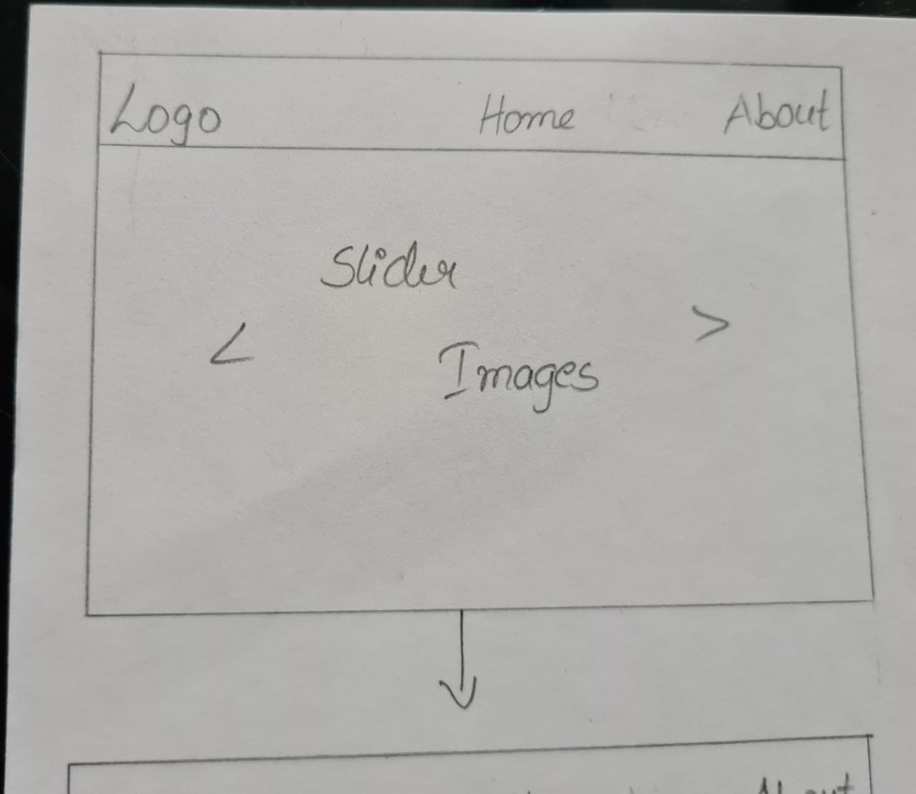
Scroll Down

Slide 9
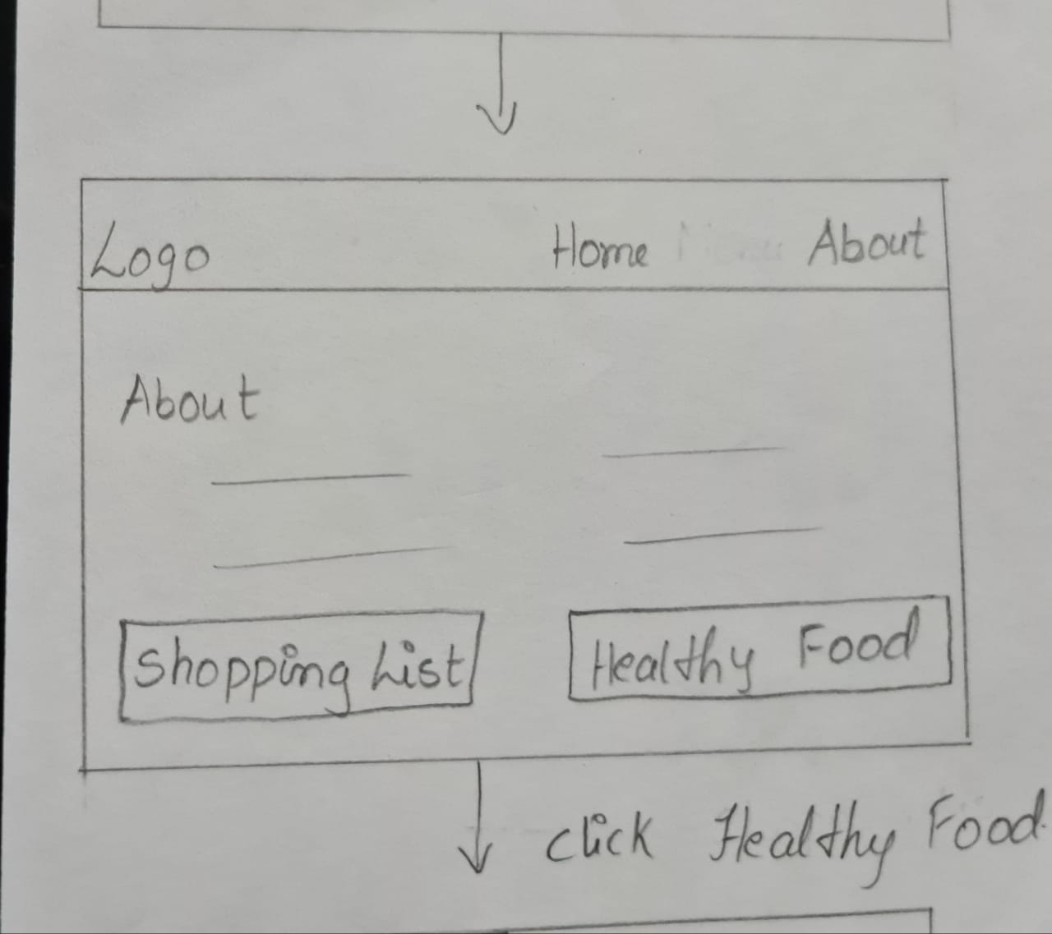
The nav bar which is fixed makes easier for accessing the important links

Slide 10
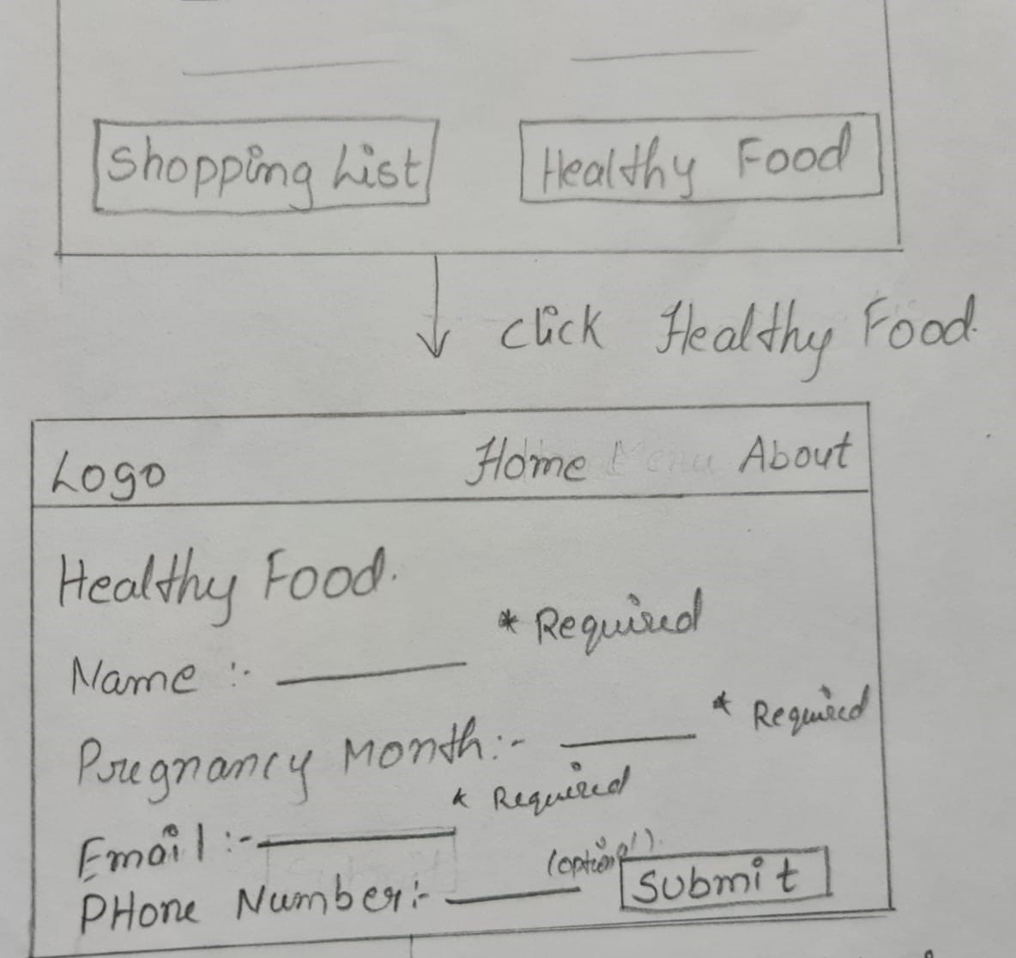
Selecting healthy food button on navbar takes to the form
A HTML form

Slide 11
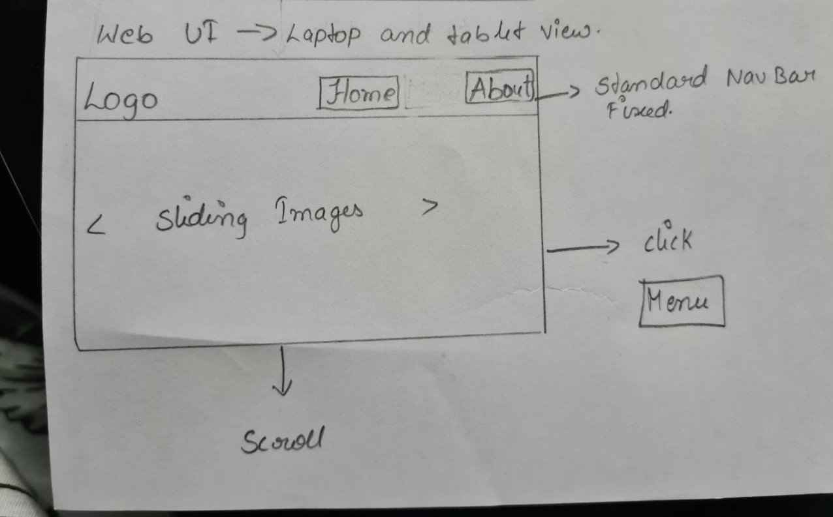

Slide 12
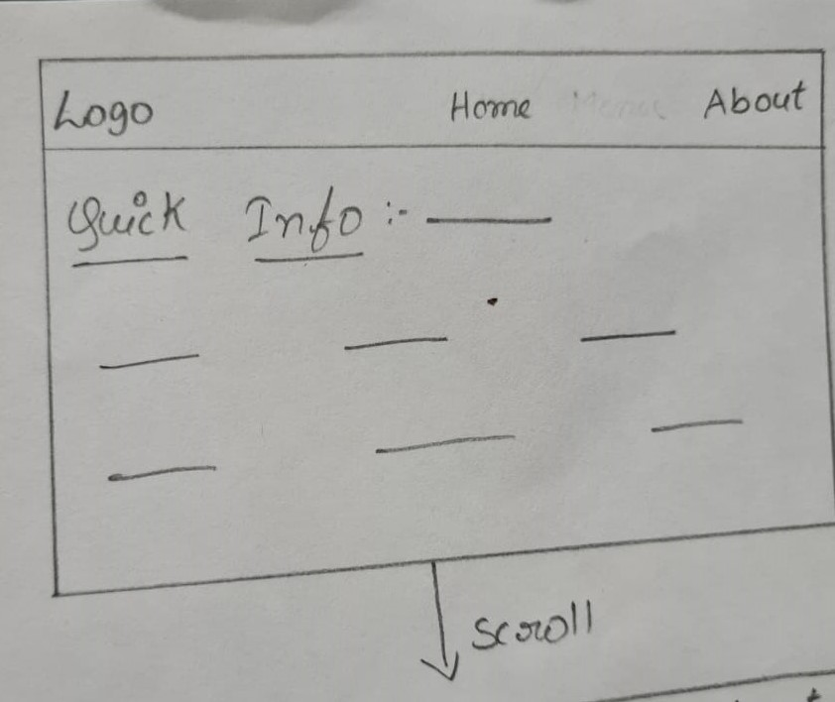

Slide 13
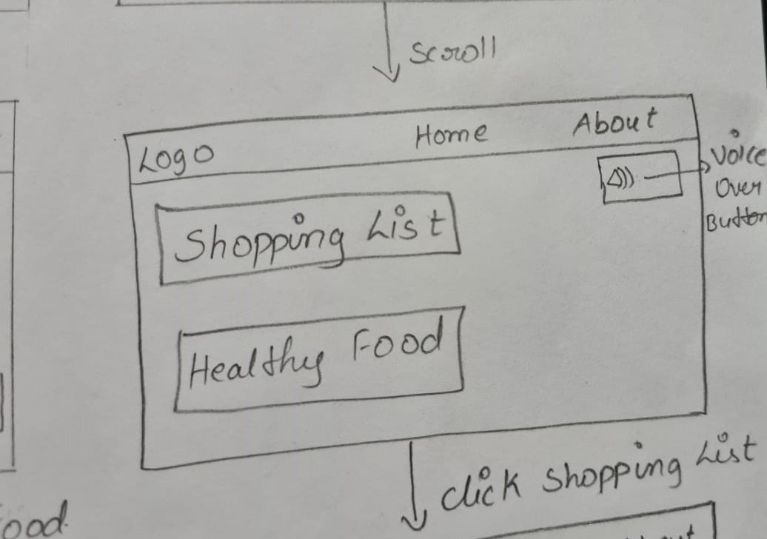

Slide 14
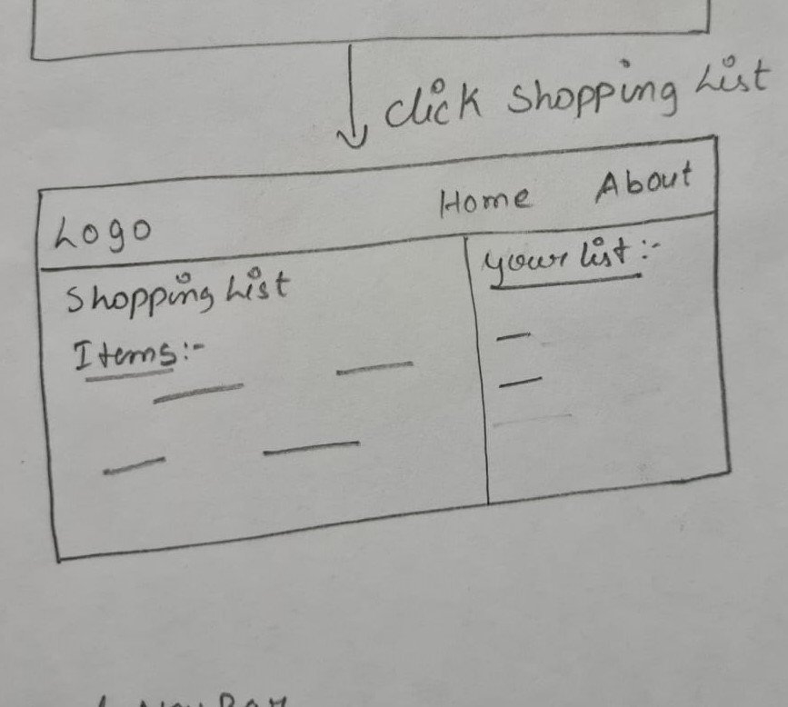
Shopping List:

Slide 15
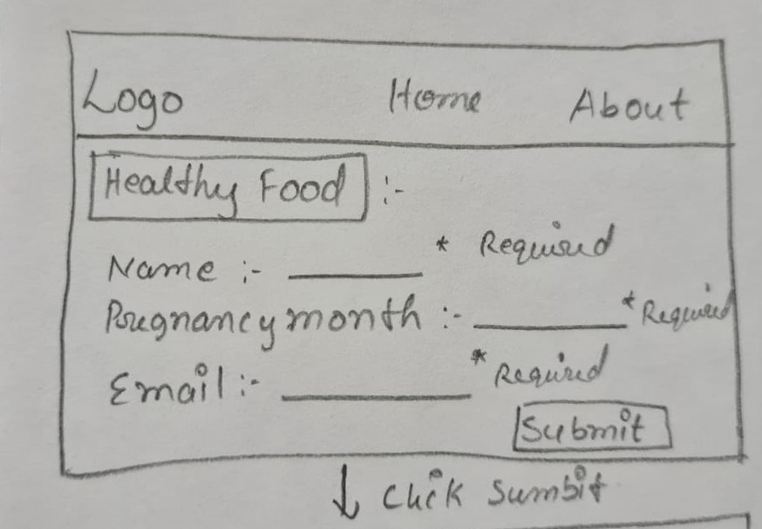

Slide 16
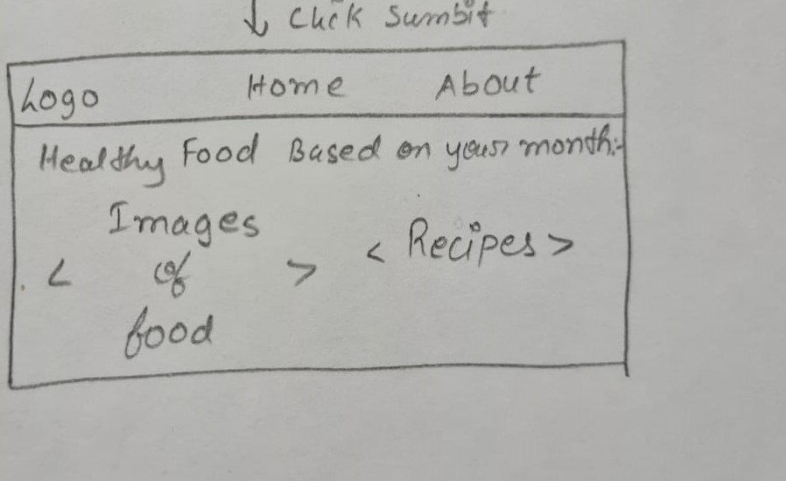

Slide 17
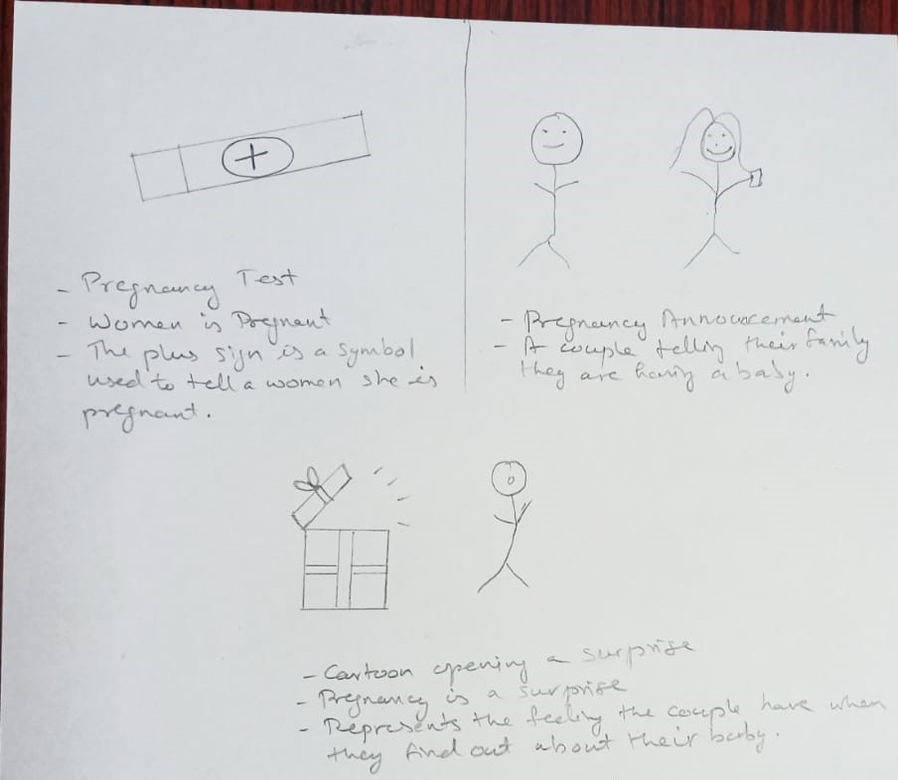
Healthy Pregnancy :

Slide 18
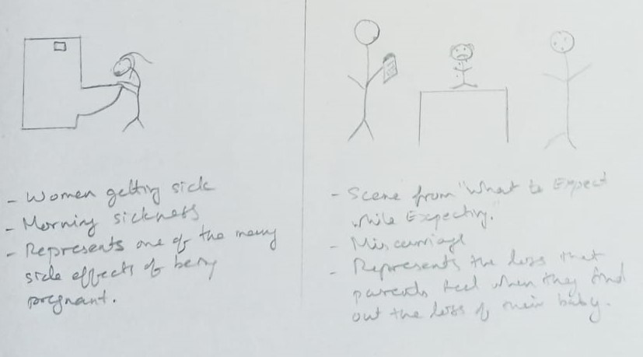

Slide 19
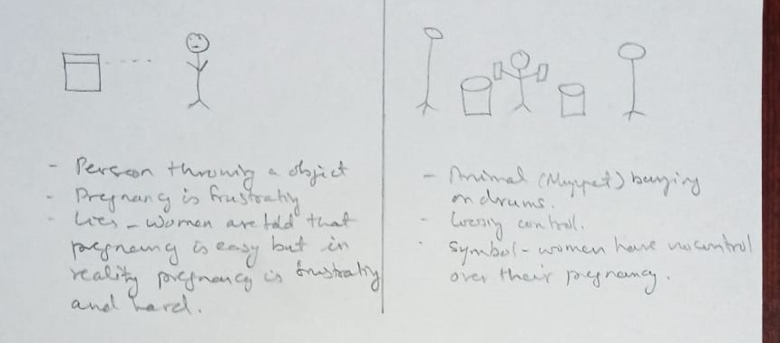

Slide 20
